Slide 1
EDGES, CORNERS, AND BLOBS

Slide 2
EDGE DETECTION
Slides from Svetlana Lazebnik

Slide 3
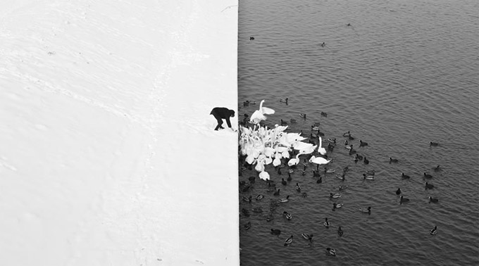
Edge Detection
Winter in Kraków photographed by Marcin Ryczek

Slide 4
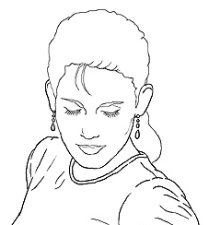
Edge Detection
Goal: Identify sudden changes (discontinuities) in an image
Intuitively, most semantic and shape information from the image can be encoded in the edges
More compact than pixels
Ideal: artist’s line drawing (but artist is also using object-level knowledge)
Source: D. Lowe

Slide 5
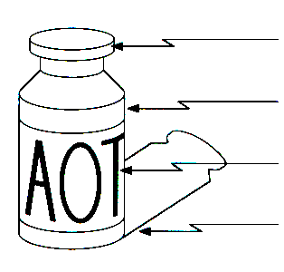
Origin of Edges
Edges are caused by a variety of factors:
surface normal discontinuity
depth discontinuity
surface color discontinuity
illumination discontinuity
Source: Steve Seitz

Slide 6
Review: Linear Filtering
Image blurring
Separability
Median filtering

Slide 7

Edge Detection
An edge is a place of rapid change in the image intensity function
intensity function (along horizontal scanline)
image
first derivative
edges correspond to extrema of derivative

Slide 8
Derivatives with Convolution
For 2D function f(x,y), the partial derivative is:
For discrete data, we can approximate using finite differences:
To implement the above as convolution, what would be the associated filter?
Source: K. Grauman

Slide 9
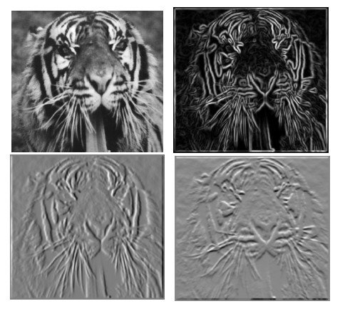
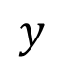
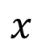
Partial Derivatives of an Image
$$y$$
$$x$$
-1 1
1 -1
-1 1
or
Which shows changes with respect to x?

Slide 10
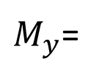
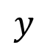
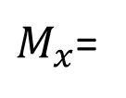
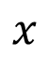
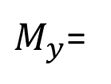
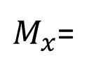
Finite Difference Filters
$$y$$
Other approximations of derivative filters
-1 | -1 | -1
0 | 0 | 0
1 | 1 | 1
-1 | 0 | 1
-1 | 0 | 1
-1 | 0 | 1
$$x$$
Prewitt
$M_{x}$=
$M_{y}$=
-1 | -2 | -1
0 | 0 | 0
1 | 2 | 1
-1 | 0 | 1
-2 | 0 | 2
-1 | 0 | 1
Sobel
$M_{x}$=
$M_{y}$=

Slide 11

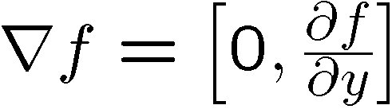

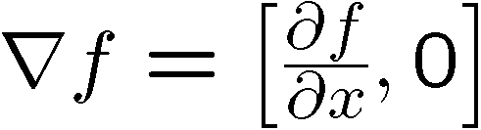
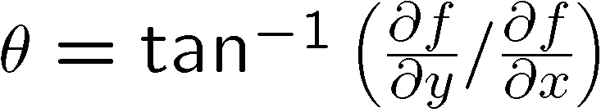
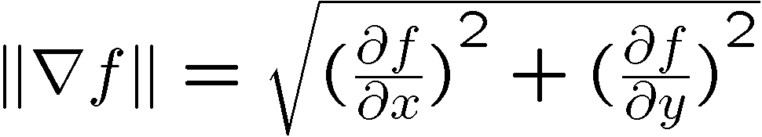
Image Gradient
The gradient of an image:
The gradient points in the direction of most rapid increase in intensity
How does this direction relate to the direction of the edge?
The gradient direction is given by
The edge strength is given by the gradient magnitude
Source: Steve Seitz

Slide 12
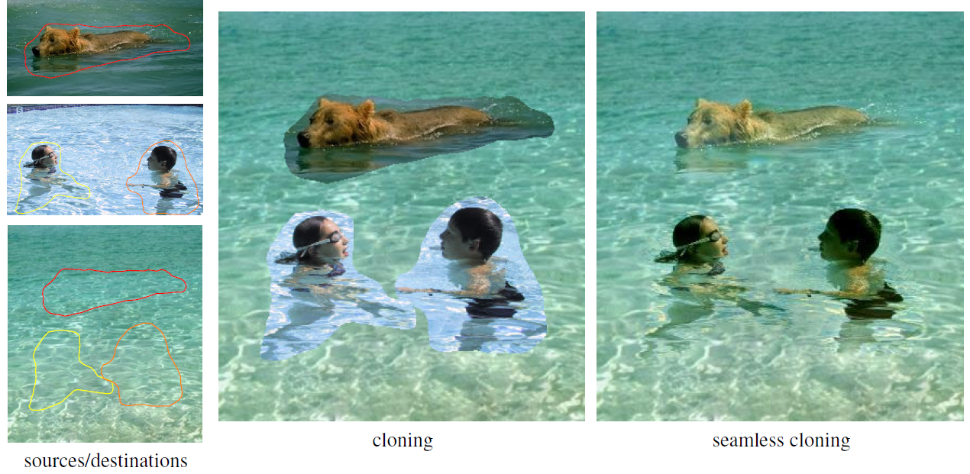
Application: Gradient-Domain Image Editing
Goal: solve for pixel values in the target region to match gradients of the source region while keeping background pixels the same
P. Perez, M. Gangnet, A. Blake, Poisson Image Editing, SIGGRAPH 2003

Slide 13
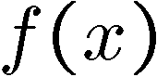
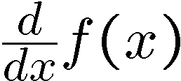
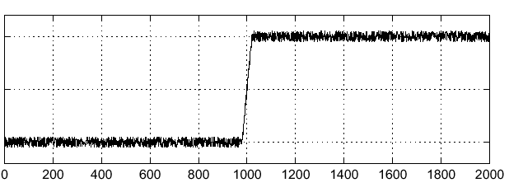
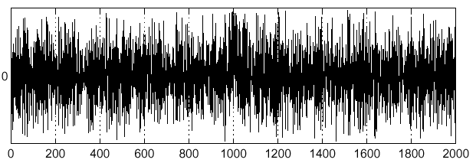
Effects of Noise
Consider a single row or column of the image
Where is the edge?
Source: S. Seitz
Notes:
How to fix?

Slide 14
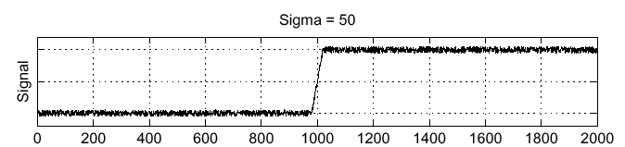
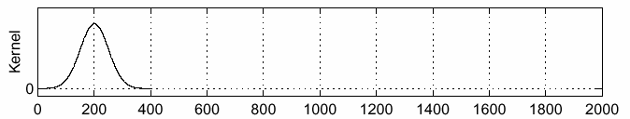
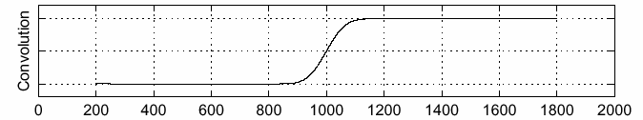
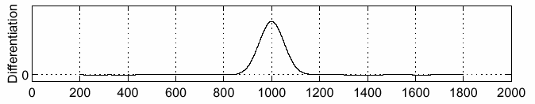
Solution: Smooth First
f
g
f * g
To find edges, look for peaks in
Source: S. Seitz

Slide 15
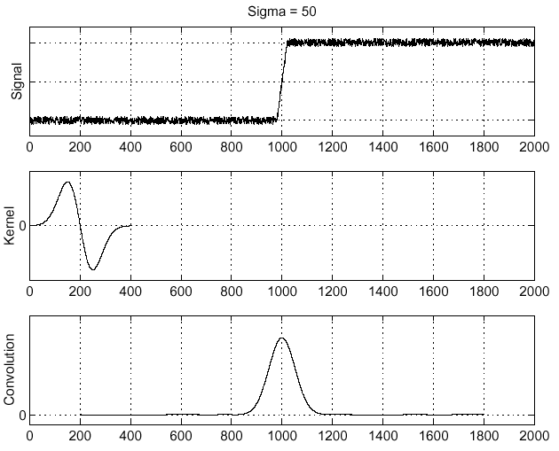
Derivative Theorem of Convolution
Differentiation is convolution, and convolution is associative:
This saves us one operation:
f
Source: S. Seitz

Slide 16
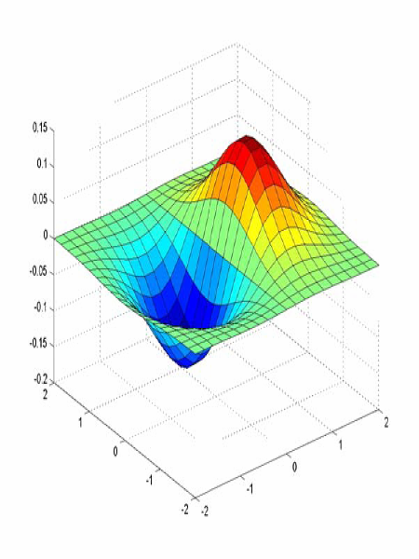
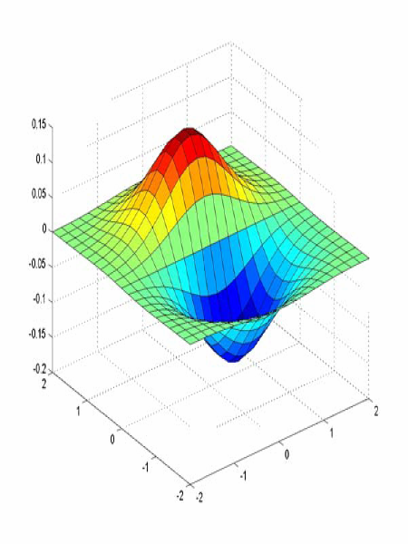
Derivative of Gaussian Filters
x-direction
y-direction
Which one finds horizontal/vertical edges?

Slide 17
Derivative of Gaussian Filters
x-direction
y-direction
Are these filters separable?

Slide 18
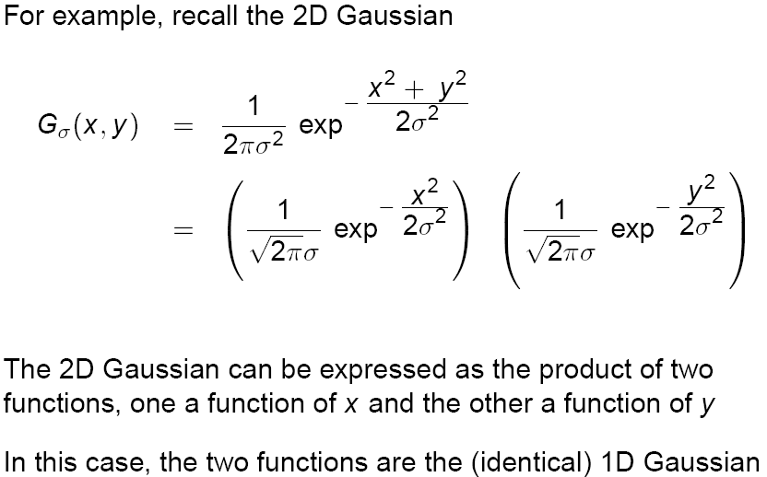
Recall: Separability of the Gaussian Filter
Source: D. Lowe

Slide 19
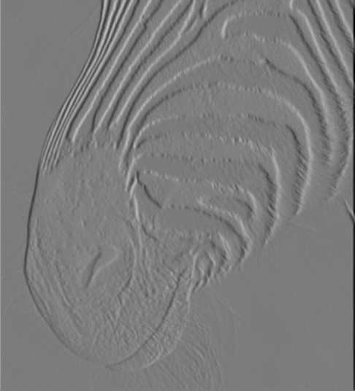
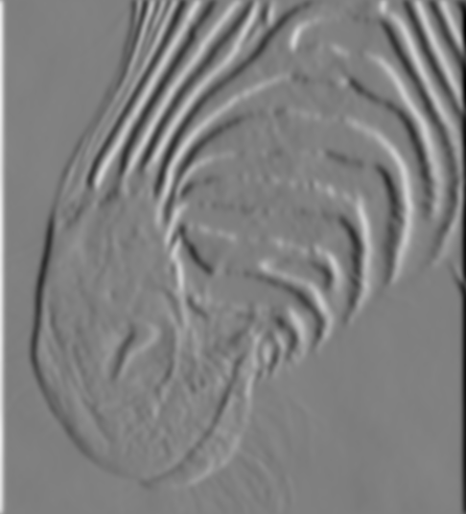
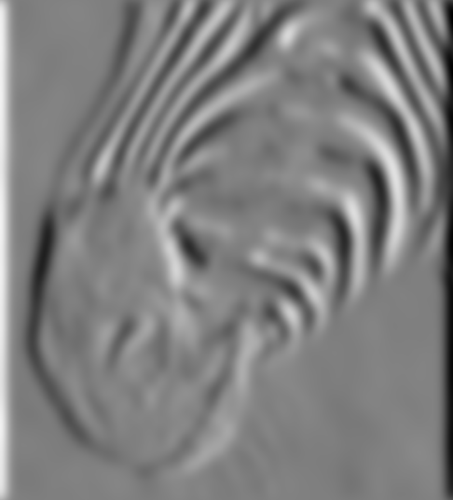
Scale of Gaussian Derivative Filter
1 pixel
3 pixels
7 pixels
Smoothed derivative removes noise, but blurs edge. Also finds edges at different “scales”
Source: D. Forsyth

Slide 20
Review: Smoothing vs. Derivative Filters
Smoothing filters
Gaussian: remove “high-frequency” components; “low-pass” filter
Can the values of a smoothing filter be negative?
What should the values sum to?
One: constant regions are not affected by the filter
Derivative filters
Derivatives of Gaussian
Can the values of a derivative filter be negative?
What should the values sum to?
Zero: no response in constant regions
High absolute value at points of high contrast

Slide 21
The Canny Edge Detector
Filter image with derivative of Gaussian
Find magnitude and orientation of gradient
Non-maximum suppression:
Thin wide “ridges” down to single pixel width
Linking and thresholding (hysteresis):
Define two thresholds: low and high
Use the high threshold to start edge curves and the low threshold to continue them
J. Canny, A Computational Approach To Edge Detection, IEEE Trans. Pattern Analysis and Machine Intelligence, 8:679-714, 1986.

Slide 22

The Canny Edge Detector
original image
Slide credit: Steve Seitz

Slide 23
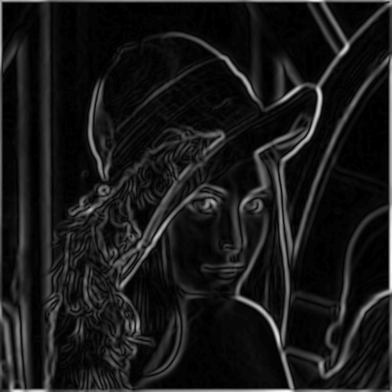
The Canny Edge Detector
norm of the gradient

Slide 24
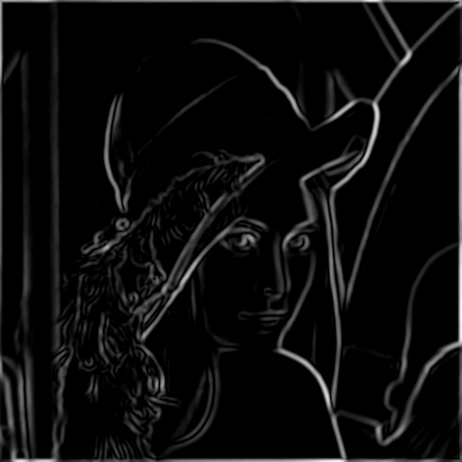
The Canny Edge Detector
thresholding

Slide 25
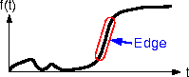
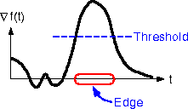
The Canny Edge Detector
How to turn these thick regions of the gradient into curves?
thresholding

Slide 26

Non-Maximum Suppression
Check if pixel is local maximum along gradient direction, select single max across width of the edge
requires checking interpolated pixels p and r

Slide 27
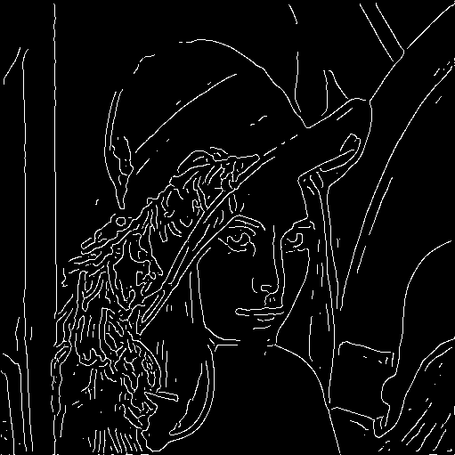
The Canny Edge Detector
Problem: pixels along this edge didn’t survive the thresholding
thinning
(non-maximum suppression)

Slide 28
Hysteresis Thresholding
Use a high threshold to start edge curves, and a low threshold to continue them.
Source: Steve Seitz

Slide 29
Hysteresis Thresholding
original image
high threshold
(strong edges)
low threshold
(weak edges)
hysteresis threshold
Source: L. Fei-Fei

Slide 30
Recap: Canny Edge Detector
Compute x and y gradient images
Find magnitude and orientation of gradient
Non-maximum suppression:
Thin wide “ridges” down to single pixel width
Linking and thresholding (hysteresis):
Define two thresholds: low and high
Use the high threshold to start edge curves and the low threshold to continue them
J. Canny, A Computational Approach To Edge Detection, IEEE Trans. Pattern Analysis and Machine Intelligence, 8:679-714, 1986.

Slide 31
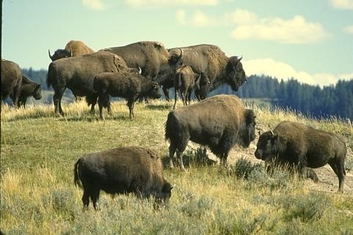
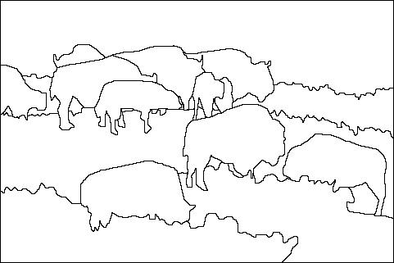
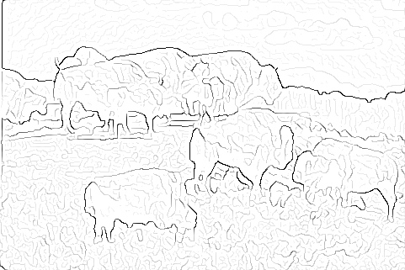

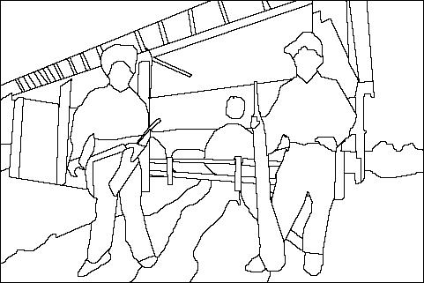
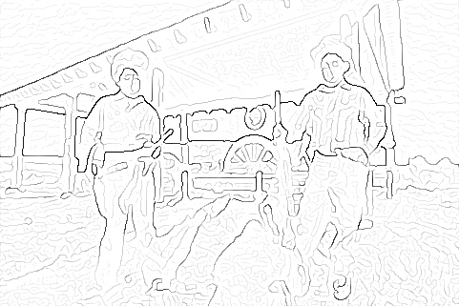
Image Gradients vs. Meaningful Contours
image
human segmentation
gradient magnitude
Berkeley segmentation database: http://www.eecs.berkeley.edu/Research/Projects/CS/vision/grouping/segbench/

Slide 32
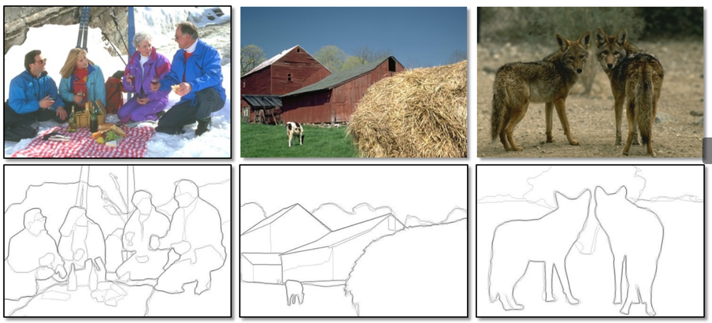
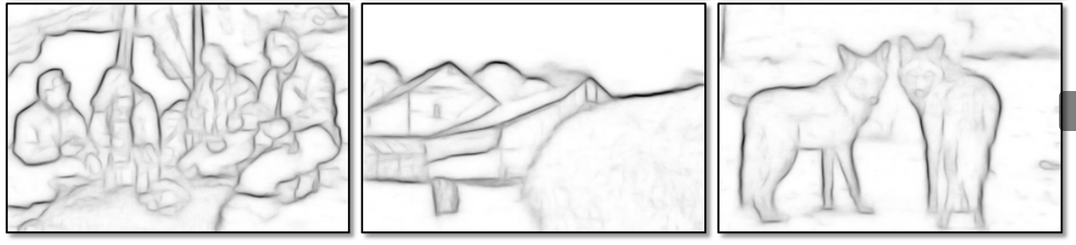
Data-Driven Edge Detection
Input images
Training data
Ground truth
Output
P. Dollar and L. Zitnick, Structured forests for fast edge detection, ICCV 2013

Slide 33
CORNERS
Slides are from Svetlana Lzebnik

Slide 34
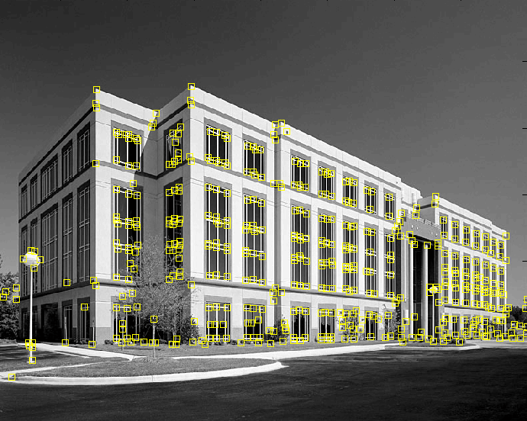
Feature Extraction: Corners
9300 Harris Corners Pkwy, Charlotte, NC

Slide 35


Why Extract Features?
Motivation: panorama stitching
We have two images – how do we combine them?

Slide 36


Why Extract Features?
Motivation: panorama stitching
We have two images – how do we combine them?
Step 1: extract features
Step 2: match features

Slide 37

Why Extract Features?
Motivation: panorama stitching
We have two images – how do we combine them?
Step 1: extract features
Step 2: match features
Step 3: align images

Slide 38
Characteristics of Good Features
Repeatability
The same feature can be found in several images despite geometric and photometric transformations
Saliency
Each feature is distinctive
Compactness and efficiency
Many fewer features than image pixels
Locality
A feature occupies a relatively small area of the image; robust to clutter and occlusion

Slide 39
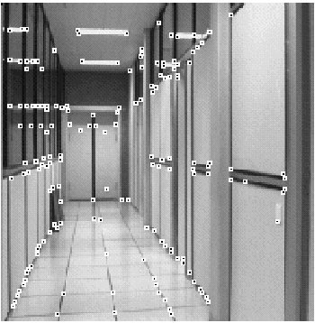
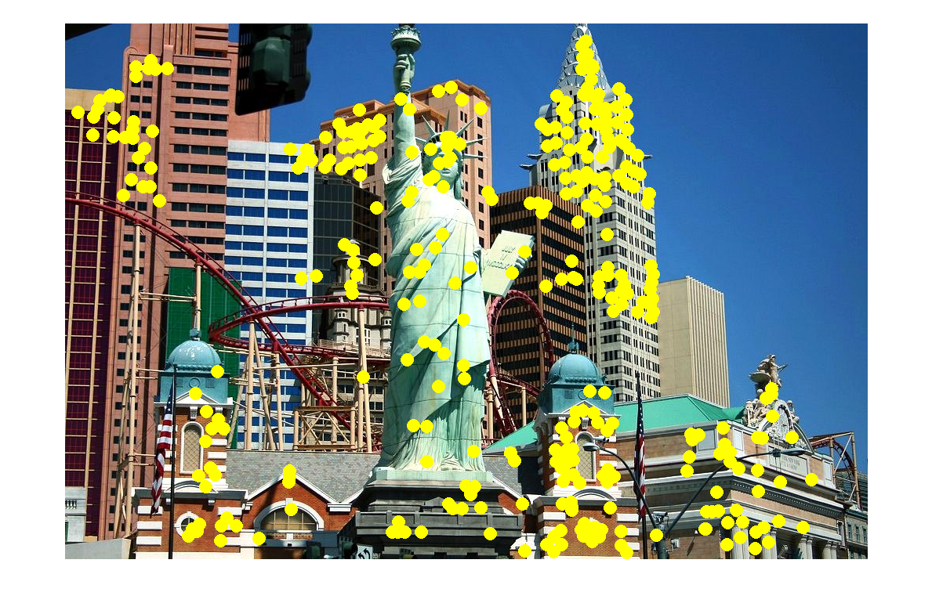
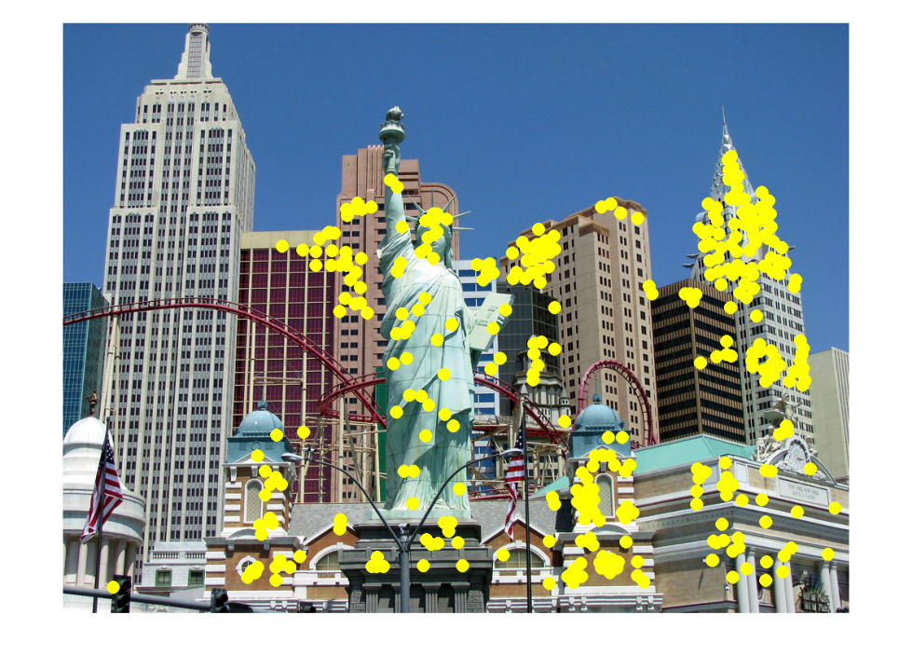
Applications
Feature points are used for:
Image alignment
3D reconstruction
Motion tracking
Robot navigation
Indexing and database retrieval
Object recognition

Slide 40
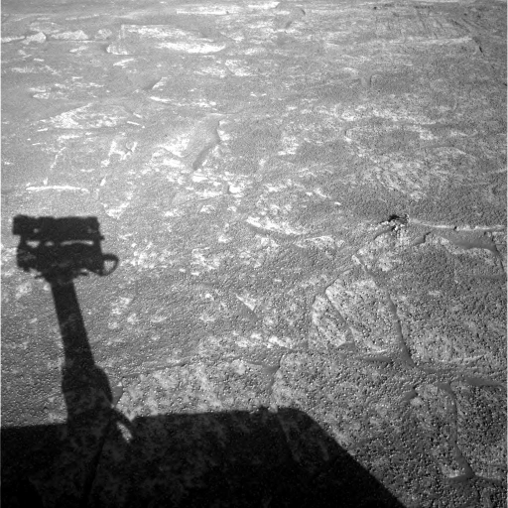
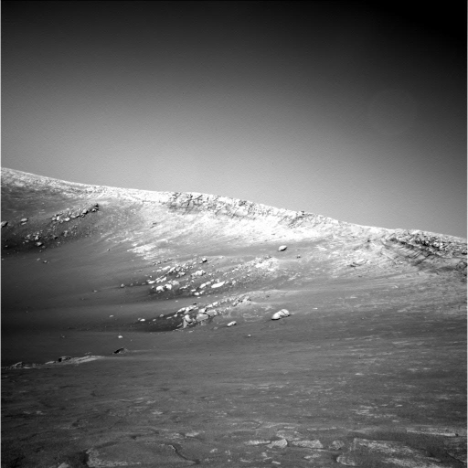
A Hard Feature Matching Problem
NASA Mars Rover images

Slide 41


Answer Below (look for tiny colored squares…)
NASA Mars Rover images
with SIFT feature matches Figure by Noah Snavely

Slide 42

Corner Detection: Basic Idea
We should easily recognize the point by looking through a small window
Shifting a window in any direction should give a large change in intensity
“flat” region: no change in all directions
“edge”: no change along the edge direction
“corner”: significant change in all directions

Slide 43


Corner Detection: Mathematics
Change in appearance of window W for the shift [u,v]:
I(x, y)
E(u, v)
E(3,2)

Slide 44
Corner Detection: Mathematics
Change in appearance of window W for the shift [u,v]:
I(x, y)
E(u, v)
E(0,0)

Slide 45
Corner Detection: Mathematics
Change in appearance of window W for the shift [u,v]:
We want to find out how this function behaves for small shifts
E(u, v)
Notes:
Specifically, E has to have a unique minimum at (0,0)

Slide 46
Corner Detection: Mathematics
First-order Taylor approximation for small motions [u, v]:
Let’s plug this into E(u,v):

Slide 47
Corner Detection: Mathematics
The quadratic approximation can be written as
where M is a second moment matrix computed from image derivatives:
(the sums are over all the pixels in the window W)

Slide 48

Interpreting the Second Moment Matrix
The surface E(u,v) is locally approximated by a quadratic form. Let’s try to understand its shape.
Specifically, in which directions does it have the smallest/greatest change?
E(u, v)

Slide 49
Interpreting the Second Moment Matrix
First, consider the axis-aligned case (gradients are either horizontal or vertical)
If either a or b is close to 0, then this is not a corner, so look for locations where both are large.

Slide 50

Interpreting the Second Moment Matrix
Consider a horizontal “slice” of E(u, v):
This is the equation of an ellipse.

Slide 51
Interpreting the Second Moment Matrix
Consider a horizontal “slice” of E(u, v):
This is the equation of an ellipse.
Diagonalization of M:
The axis lengths of the ellipse are determined by the eigenvalues and the orientation is determined by R
direction of the fastest change
direction of the slowest change
(λ_{max})^{-1/2}
(λ_{min})^{-1/2}

Slide 52

Visualization of Second Moment Matrices

Slide 53

Visualization of Second Moment Matrices

Slide 54
Interpreting the Eigenvalues
Classification of image points using eigenvalues of M:
λ₂
“Edge” λ₂ >> λ₁
“Corner” λ₁ and λ₂ are large, λ₁ ~ λ₂; E increases in all directions
λ₁ and λ₂ are small; E is almost constant in all directions
“Flat” region
“Edge” λ₁ >> λ₂
λ₁

Slide 55
Corner Response Function
α: constant (0.04 to 0.06)
“Edge” R < 0
“Corner” R > 0
|R| small
“Flat” region
“Edge” R < 0

Slide 56
The Harris Corner Detector
Compute partial derivatives at each pixel
Compute second moment matrix M in a Gaussian window around each pixel:
C.Harris and M.Stephens. “A Combined Corner and Edge Detector.” Proceedings of the 4th Alvey Vision Conference: pages 147—151, 1988.

Slide 57
The Harris Corner Detector
Compute partial derivatives at each pixel
Compute second moment matrix M in a Gaussian window around each pixel
Compute corner response function R
C.Harris and M.Stephens. “A Combined Corner and Edge Detector.” Proceedings of the 4th Alvey Vision Conference: pages 147—151, 1988.

Slide 58

Harris Detector: Steps

Slide 59

Harris Detector: Steps
Compute corner response R

Slide 60
The Harris Corner Detector
Compute partial derivatives at each pixel
Compute second moment matrix M in a Gaussian window around each pixel
Compute corner response function R
Threshold R
Find local maxima of response function (nonmaximum suppression)
C.Harris and M.Stephens. “A Combined Corner and Edge Detector.” Proceedings of the 4th Alvey Vision Conference: pages 147—151, 1988.

Slide 61

Harris Detector: Steps
Find points with large corner response: R > threshold

Slide 62

Harris Detector: Steps
Take only the points of local maxima of R

Slide 63

Harris Detector: Steps

Slide 64
Invariance and Covariance
We want corner locations to be invariant to photometric transformations and covariant to geometric transformations
Invariance: image is transformed and corner locations do not change
Covariance: if we have two transformed versions of the same image, features should be detected in corresponding locations

Slide 65
Activity
Discuss in pairs and decide:
I may randomly ask a pair to respond.
Is Harris corner detection invariant to
Affine intensity changes
Image translation
Image rotation
Image scaling
I → a I + b

Slide 66
Affine Intensity Change
I → a I + b
Only derivatives are used => invariance to intensity shift I → I + b
Intensity scaling: I → a I
R
R
threshold
x (image coordinate)
x (image coordinate)
Partially invariant to affine intensity change

Slide 67
Image Translation
Derivatives and window function are shift-invariant
Corner location is covariant w.r.t. translation

Slide 68
Image Rotation
Second moment ellipse rotates but its shape (i.e. eigenvalues) remains the same
Corner location is covariant w.r.t. rotation

Slide 69
Scaling
Corner
All points will be classified as edges
Corner location is not covariant to scaling!

Slide 70
BLOB DETECTION
Slides from Svetlana Lazebnik

Slide 71

Blob Detection

Slide 72
Feature Detection with Scale Selection
We want to extract features with characteristic scale that is covariant with the image transformation

Slide 73

Blob Detection: Basic idea
To detect blobs, convolve the image with a “blob filter” at multiple scales and look for extrema of filter response in the resulting scale space.

Slide 74



Blob Detection: Basic Idea
minima
*
=
maxima
Find maxima and minima of blob filter response in space and scale
Source: N. Snavely

Slide 75

Blob Filter
Laplacian of Gaussian: Circularly symmetric operator for blob detection in 2D

Slide 76
Recall: Edge Detection
Edge
f
Derivative of Gaussian
Edge = maximum of derivative
Source: S. Seitz

Slide 77

Edge Detection, Take 2
f
Edge
Second derivative of Gaussian (Laplacian)
Edge = zero crossing of second derivative
Source: S. Seitz
Notes:
An edge filtered with the Laplacian of Gaussian is the difference between the blurry edge and the original edge.

Slide 78

From Edges to Blobs
Edge = ripple
Blob = superposition of two ripples
maximum
Spatial selection: the magnitude of the Laplacian response will achieve a maximum at the center of the blob, provided the scale of the Laplacian is “matched” to the scale of the blob

Slide 79

Scale Selection
We want to find the characteristic scale of the blob by convolving it with Laplacians at several scales and looking for the maximum response
However, Laplacian response decays as scale increases:
original signal (radius=8)
increasing σ

Slide 80

Scale Normalization
The response of a derivative of Gaussian filter to a perfect step edge decreases as σ increases
Notes:
The area under the first derivative of Gaussian from –infinity to 0 is equal to the value of the Gaussian at zero

Slide 81
Scale Normalization
The response of a derivative of Gaussian filter to a perfect step edge decreases as σ increases
To keep response the same (scale-invariant), must multiply Gaussian derivative by σ
Laplacian is the second Gaussian derivative, so it must be multiplied by σ²

Slide 82

Effect of Scale Normalization
Original signal
Unnormalized Laplacian response
Scale-normalized Laplacian response
maximum

Slide 83
Blob Detection in 2D
Laplacian of Gaussian: Circularly symmetric operator for blob detection in 2D
Scale-normalized:

Slide 84
Scale Selection
At what scale does the Laplacian achieve a maximum response to a binary circle of radius r?
r
image
Laplacian

Slide 85
Scale Selection
At what scale does the Laplacian achieve a maximum response to a binary circle of radius r?
To get maximum response, the zeros of the Laplacian have to be aligned with the circle
The Laplacian is given by (up to scale):
Therefore, the maximum response occurs at
circle
r
0
Laplacian
image

Slide 86


Slide 87

Characteristic Scale
We define the characteristic scale of a blob as the scale that produces peak of Laplacian response in the blob center
characteristic scale
T. Lindeberg (1998). "Feature detection with automatic scale selection." International Journal of Computer Vision 30 (2): pp 77--116.

Slide 88
Scale-Space Blob Detector
Convolve image with scale-normalized Laplacian at several scales

Slide 89

Scale-Space Blob Detector: Example

Slide 90










Scale-Space Blob Detector: Example

Slide 91

Scale-Space Blob Detector
Convolve image with scale-normalized Laplacian at several scales
Find maxima of squared Laplacian response in scale-space

Slide 92

Scale-Space Blob Detector: Example

Slide 93

Efficient Implementation
Approximating the Laplacian with a difference of Gaussians:
(Laplacian)
(Difference of Gaussians)

Slide 94

Efficient Implementation
David G. Lowe. "Distinctive image features from scale-invariant keypoints.” IJCV 60 (2), pp. 91-110, 2004.

Slide 95


From Feature Detection to Feature Description
Scaled and rotated versions of the same neighborhood will give rise to blobs that are related by the same transformation
What to do if we want to compare the appearance of these image regions?
Normalization: transform these regions into same-size circles
Problem: rotational ambiguity

Slide 96

Eliminating Rotation Ambiguity
To assign a unique orientation to circular image windows:
Create histogram of local gradient directions in the patch
Assign canonical orientation at peak of smoothed histogram
0
2
π

Slide 97


SIFT Features
Detected features with characteristic scales and orientations:
David G. Lowe. "Distinctive image features from scale-invariant keypoints.” IJCV 60 (2), pp. 91-110, 2004.

Slide 98

From Feature Detection to Feature Description
Detection is covariant:
features(transform(image)) = transform(features(image))
Description is invariant:
features(transform(image)) = features(image)

Slide 99

SIFT Descriptors
David G. Lowe. "Distinctive image features from scale-invariant keypoints.” IJCV 60 (2), pp. 91-110, 2004.

Slide 100


Properties of SIFT
Extraordinarily robust detection and description technique
Can handle changes in viewpoint
Up to about 60 degree out-of-plane rotation
Can handle significant changes in illumination
Sometimes even day vs. night
Fast and efficient—can run in real time
Lots of code available
Source: N. Snavely

Slide 101


Affine adaptation
Affine transformation approximates viewpoint changes for roughly planar objects and roughly orthographic cameras

Slide 102
Affine Adaptation
Consider the second moment matrix of the window containing the blob:
direction of the fastest change
Recall:
direction of the slowest change
(λ_{max})^{-1/2}
(λ_{min})^{-1/2}
This ellipse visualizes the “characteristic shape” of the window

Slide 103
Affine Adaptation Example
Scale-invariant regions (blobs)

Slide 104

Affine Adaptation Example
Affine-adapted blobs

